Slide 1
Lecture 4
Analyzing Risk: Incorporating Uncertainty into the Decisions of the Enterprise

Slide 2
Module 2 Study Guide and Deliverables
Topics: | Lectures 3: Analyzing Risk: An Introduction to Modeling Uncertain Inputs Lectures 4: Analyzing Risk: Incorporating Uncertainty into the Decisions of the Enterprise
Readings: | Lectures 3 and 4 online content
Discussions: | Module 2 Discussion
Assignments: | Assignment 2: Individual Assignment covering Lecture 3 and Lecture 4.
Assessments: | Quiz 2

Slide 3
Learning Objectives
After you complete this lecture, you will be familiar with the following concepts:
Percentiles of the simulation output data
Constructing confidence intervals for the mean
Determining number of iterations in a simulation study
Sensitivity analysis using R
Creating and interpreting an overlay chart in R
Creating and interpreting a trend chart in R
Creating and interpreting a box whisker chart in R

Slide 4
New-Product Development Model – Deterministic Model¹
In this module, we will be working with the following new-product development model:
Suppose that ACG Pharmaceuticals has discovered a potential drug breakthrough in the laboratory and needs to decide whether to go forward to conduct clinical trials and seek FDA approval to market the drug. Total R&D costs are expected to reach $700 million, and the cost of clinical trials will be about $150 million.
The current market size is estimated to be 2 million people and is expected to grow at a rate of 3% each year. In the first year, ACG estimates gaining an 8% market share, which is anticipated to grow by 20% each year. As new competitors are expected to enter the market, it is difficult to estimate beyond 5 years. A monthly prescription is anticipated to generate revenue of $130 while incurring variable costs of $40.
A discount rate of 9% is assumed for computing the net present value of the project.
The company needs to know how long it will take to recover its fixed expenses and the net present value over the first 5 years.
Source: Evans, J. R., Business Analytics: Methods, Models, and Decisions, 2e, 2016, Pearson Education, Inc., Chapter 11, Example 11.8, pp. 351-352.

Slide 5
New-Product Development Model – Deterministic Model¹
"The model is based on a variety of assumptions, estimates, and known data."² "In reality, most of the data used in the model are uncertain; e.g., the market size and market-share growth rates."³ We will first build a spreadsheet model based on the known data. Then, we will incorporate the uncertainties into our model and analyze the risk associated with the project.
Question: How do we come up with the data given in the problem description? Answer: Most inputs are obtained from historical data, estimates based on prior market research, and expert opinion. For now, we will take these numbers as given but later we will learn how to come up with these numbers using historical data (Lecture 5).
Individual Exercise:
Before you read further, please try to build the R model on your own.

Slide 6
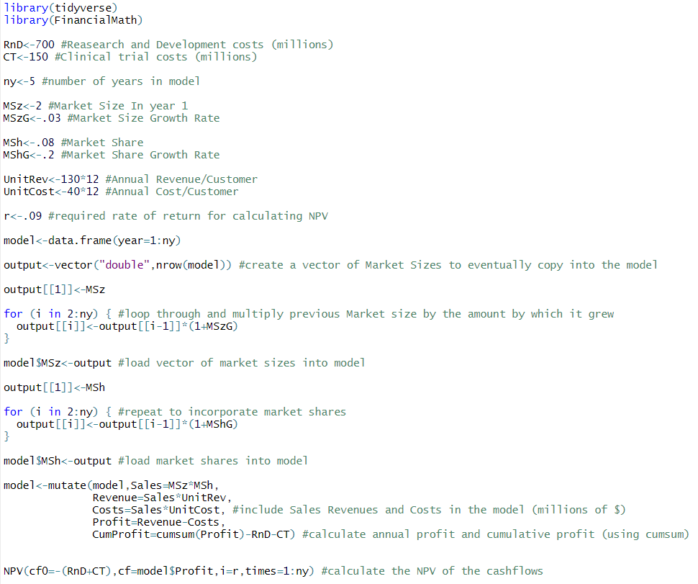
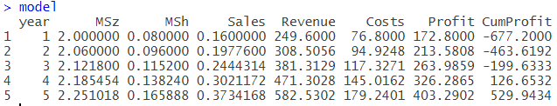
New-Product Development Model – Deterministic Model¹
Figure 4.1 presents the resulting R code and resulting model of the new-product development model.
Figure 4.1

Slide 7
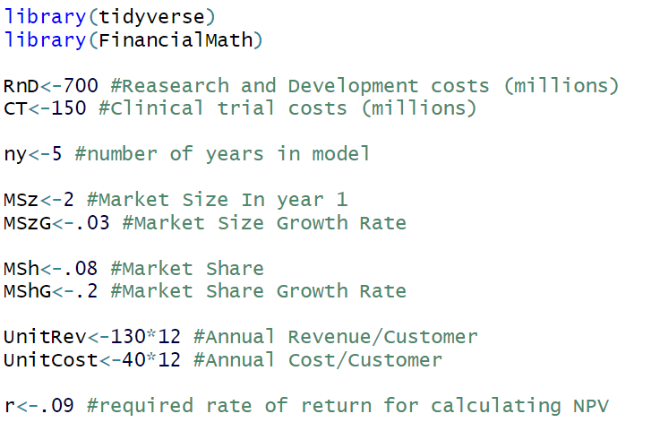
New-Product Development Model – Deterministic Model¹
We start the process by loading the tidyverse library and the FinancialMath library (for the NPV function), and defining parameters:
Figure 4.2

Slide 8
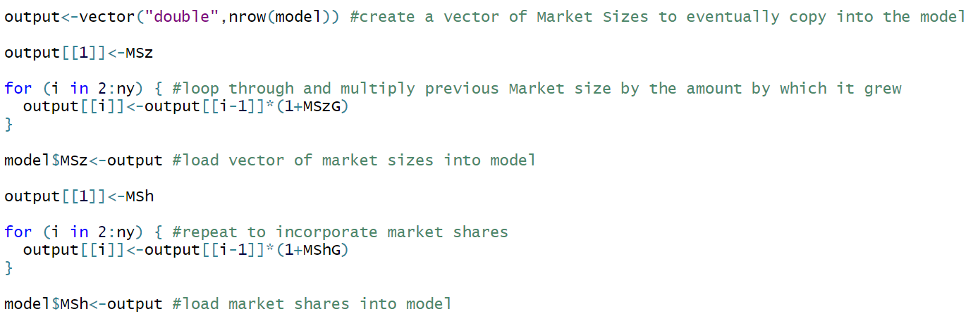
New-Product Development Model – Deterministic Model¹
We then create vectors for market size and market share, using for loops. A for loop in R will iterate over a vector specified in the parentheses, in this case it runs for each number in the set {2,3,4,5}.
For each of these numbers, it does what’s specified in the braces. Here it assigns to the second element in output 2*1.03, then the third element (2*1.03)*1.03, and so forth.
This process is repeated for market share, expressed as a percent of the total market size.
Figure 4.3

Slide 9
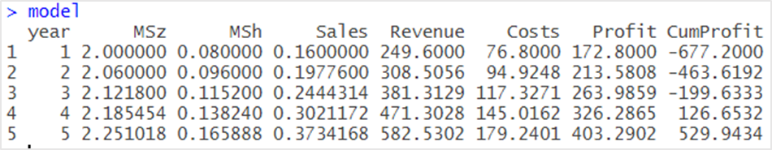
New-Product Development Model – Deterministic Model¹
We then use the mutate function to determine the calculated values for our model. Note the use of the cumsum function, which takes a vector and returns a vector of the same size, where each element is the sum of all the elements of the input vector to that point.
We use this to calculate cumulative profit, subtracting the one-time costs of R&D and clinical trials.
Figure 4.5

Slide 10
New-Product Development Model – Deterministic Model¹
Finally, we use the NPV function, incorporating the fixed costs at the start of the project and the cash flows represented by profit to determine the net present value of the deterministic model. The NPV function takes a cash flow at time 0, a vector of cash flows, and a required rate of return. We find it to be $185.4 million.
Figure 4.6

Slide 11
New-Product Development Model – Deterministic Model¹
We are now done with building our model.
Look at the CumProfit column where we calculate the cumulative net profit. We observe that the cumulative net profit is negative for the first three years and it becomes positive in the forth year. Thus, we conclude that the product becomes profitable by the fourth year. However, note that much of the data used in this model should be uncertain. For instance, the market size, R&D costs, clinical trial costs, etc. may likely not end up at the single value that we chose for them. Thus, it is natural to ask "what is the risk associated with this project?"
“More specifically, we are interested in answering the following questions:
What is the risk that the net present value over the 5 years will not be positive?
What are the chances that the product will show a cumulative net profit in the third year?
What cumulative profit in the fifth year are we likely to observe with a probability of at least 0.9?”
Source: Evans, J. R., Business Analytics: Methods, Models, and Decisions, 2e, 2016, Pearson Education, Inc., Chapter 11, Example 11.8, pp. 388.
To be able to answer these questions, we will need to simulate the new-product development model. We will build the simulation model in the next section

Slide 12
Building the Simulation Model⁴
In building our simulation model we will follow the 5 steps that was outlined in Lecture 2. We are already done with Step 1; i.e., we have started with the deterministic model and constructed a model that relates inputs to the output measures.
We will now define the inputs that are uncertain along with their probability distributions; then select one or more outputs to record over the simulation runs; determine number of trials for the simulation; execute the simulation and finally analyze the results and gain insights.

Slide 13
Defining Uncertain Inputs
Suppose that we identify the following uncertain variables in the model along with their probability distributions.
Market size: normal with a mean of 2,000,000 units and a standard deviation of 400,000 units.
R&D costs: uniform between $600,000,000 and $800,000,000 (so any value between $600,000,000 and $800,000,000 is equally likely for the R&D costs.)
Clinical trial costs: lognormal with a mean of $150,000,000 and standard deviation $30,000,000.
Annual market growth factor: triangular with minimum 2%, maximum 6%, and most likely 3%.
Annual market share growth rate: triangular with minimum 15%, maximum 25%, and most likely 20%.
Source: Evans, J. R., Business Analytics: Methods, Models, and Decisions, 2e, 2016, Pearson Education, Inc., Chapter 11, Example 11.8, pp. 388

Slide 14
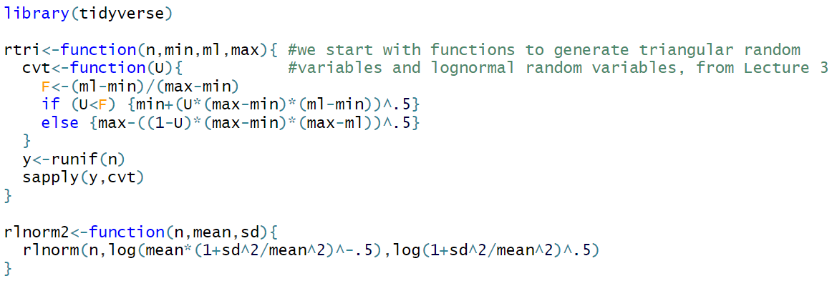
User-Defined Functions
We’ll start by loading the tidyverse library, and defining the rtri function and the rlnorm2 function we used in the previous lecture.
Figure 4.6

Slide 15
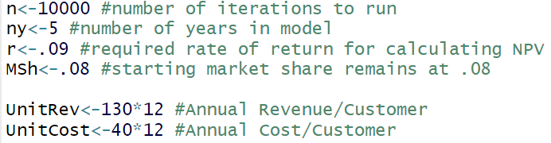
Predetermined Inputs
According to the text of the problem, the number of years, required rate of return, year 1 market share, unit revenue, and unit cost all remain fixed, as in the deterministic problem. We also choose here to run 10,000 trials.
Figure 4.7

Slide 16
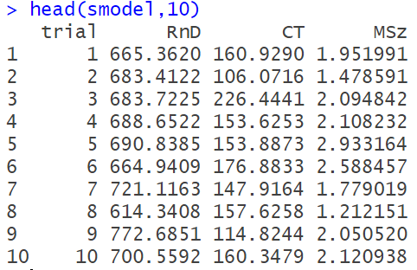
Uncertain Inputs
Here we start to build our data frame, each row of which represents one trial of the Monte Carlo simulation. We include a trial number, R&D costs, clinical trial costs, and the starting market size, all as defined by the parameters of the problem.
The first ten trials are displayed in Figure 4.8, using the head function in the console.
Figure 4.8

Slide 17
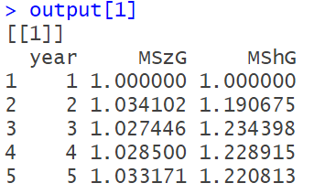
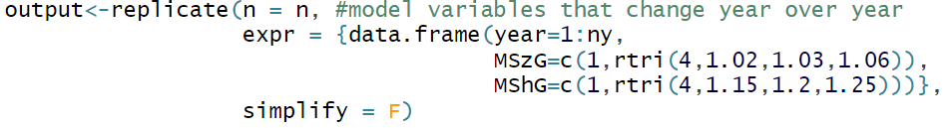
Uncertain Inputs
We next create a list of data frames, which we’ll eventually nest in our stochastic model. Each of these data frames contains the initial uncertain inputs that we need to define for each year: The growth of the market size and market share for years two through five. T
o produce this list, we use the replicate function, telling it to define a data frame 10,000 times. The result of the first replication is reproduced in figure 4.9.
To simplify our code, we take the step of adding 1 to the growth factors now.
Figure 4.9

Slide 18
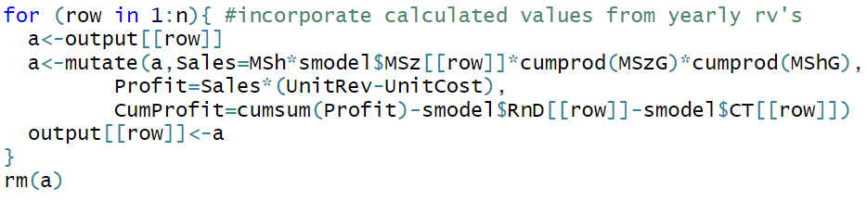
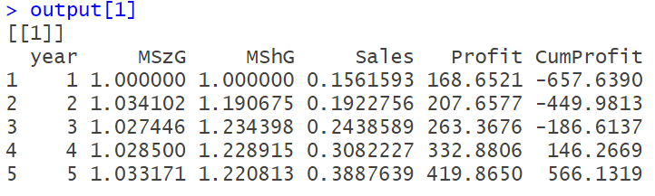
Calculating Outputs
We now use a for loop to go through each line of smodel and calculate sales for each year, profit each year, and cumulative profit each year in each of the 10,000 trials in “output”.
To prevent R from repeatedly overwriting the entirety of output, we use a temporary data frame named “a” to store these values while the calculation is being performed. Note the cumproduct function, which has the same functionality of cumsum for multiplication.
We remove “a” when the process is finished. The first entry in the newly calculated “output” is reproduced in Figure 4.10.
Figure 4.10

Slide 19
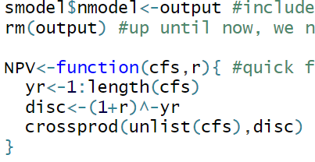
Calculating Outputs
We now nest our finished output lists into our original “smodel” data frame, under the name “nmodel”, and remove the now redundant “output” list.
We also create a quick user-defined function for NPV, that will be used to calculate the profit cash flows in nmodel. This is necessary because the NPV function in the FinancialMath library cannot readily be used with sapply. The sapply function will be explained later in this section.
This function calculates each year’s total discount, then takes the cross product (like sumproduct in Excel) of this and the list of cashflows.
Figure 4.11

Slide 20
lapply, sapply, and vapply
One very useful feature of R is that it can call other functions as one of their arguments. lapply, sapply, and vapply all take advantage of this property. As arguments, they take a vector and a function. They return, depending on the function, either a list or a vector which is the result of the function input being called on each element of the vector input. You can also pass additional arguments for the function input into the apply function.
These functions can duplicate the functionality of a for loop, but in a way that’s easier to read and code..
Individual Exercise:
Before reading further, enter “?sapply” into the console to bring up the R documentation for these functions and try some of the examples listed until you get the hang of it.

Slide 21
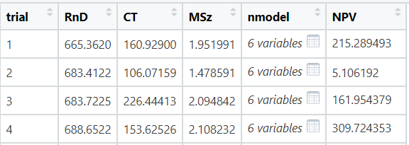

Calculating Outputs
On this line of code, we define a function just to extract the Profit vector from a data frame, and lapply it over smodel$nmodel (the list of nested data frames) to return a list of 10,000 lists of the profit the company makes each year.
We then take this list, and sapply the NPV function to it, resulting in a list of NPVs of their profits for years one through five.
Subtracting the initial cash outlays of RnD and CT shows us the total net present value for each trial. This value gets assigned as a new entry in smodel called “NPV”.
This does not print to the console nicely, but the first couple entries from View(smodel) is displayed in figure 4.12.
Figure 4.12

Slide 22

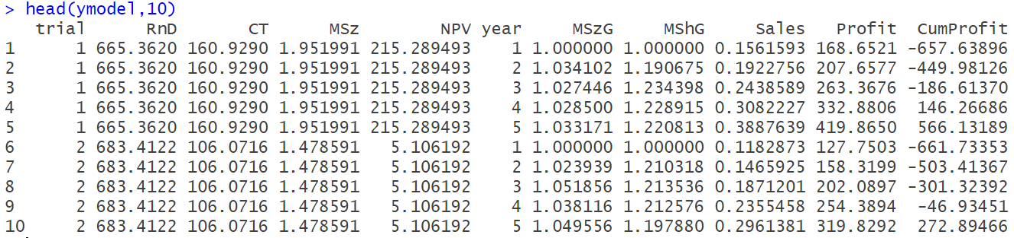
Calculating Outputs
Finally, we create a new data frame, called “ymodel”, where we unnest nmodel within smodel. This results in a data frame with 50,000 observations, putting each year from each trial in its own row. This data frame will be very helpful for calculating statistics and visualizing our results. The ten rows representing the first two trials are reproduced in Figure 4.13.
Figure 4.13

Slide 23
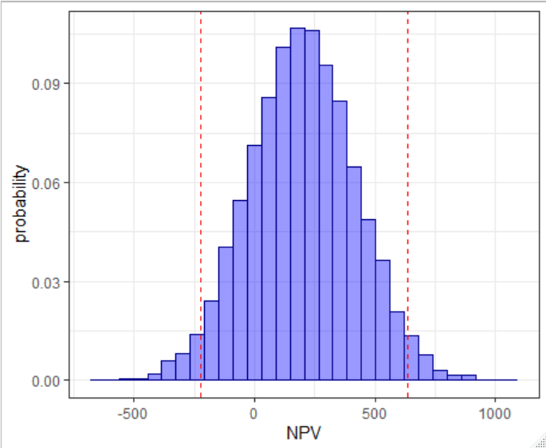
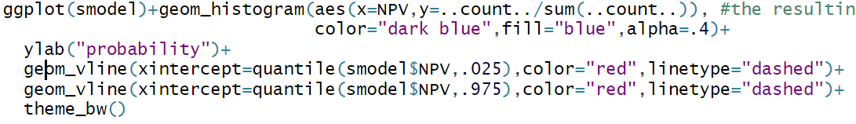
Analyzing the Outputs
We are now ready to start analyzing the risk profile of the project, in terms of cumulative net profit and net present value. We’ll start by creating a histogram of the net present value. We add dashed lines at the 97.5% quantile and 2.5% quantile of our data using geom_vline. 95% of trials fell somewhere between these two values. In this case, We had 9500 trials where the profit was between -$224 million and $637 million.
Figure 4.14

Slide 24
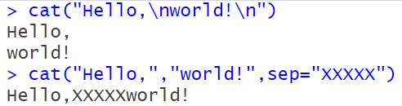
The cat Function
We then use the cat function to print to the console some information about our results. The cat function prints a string to the console, consisting of each unlabeled argument you pass the function. You can control what comes between each argument with the “sep” argument, which defaults to a single space. The cat function also allows you to put line breaks in the result wherever it reads a “\n”. Some examples are produced in Figure 4.15.
Individual Exercise:
Practice using the cat function until you feel comfortable using it. Try looking into how to use it in conjunction with the “paste” function.
Figure 4.15

Slide 25
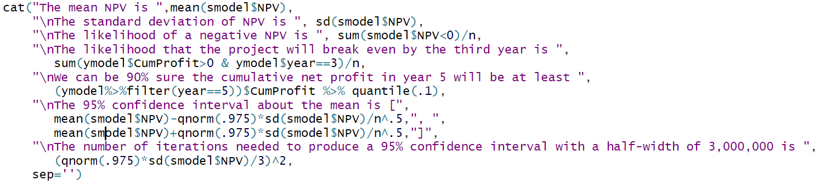
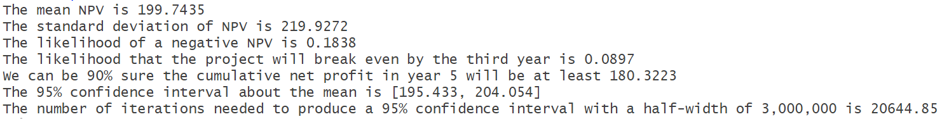
Analyzing the Outputs
We use cat to print out statistics about our model. The results can be seen in figure 4.16
Figure 4.16

Slide 26
Analyzing the Outputs
Let’s look at the first 3 lines of that output, and how we got them. The mean and standard deviation of the NPV, we simply used the mean and sd functions in R.
To determine the likelihood of a negative NPV, we first looked at smodel$NPV<0. This returns a vector of 10,000 Booleans, which we take the sum of, coercing TRUE to 1 and FALSE to 0 in the process.
Dividing by the number of trials gives us the proportion of trials where the NPV was less than 0.
Figure 4.17

Slide 27
Analyzing the Outputs
The next line of the output tells us how likely the project is to break even by the third year. To determine that, we need the cumulative profit in the third year.
For this we can use our unnested “ymodel”, filtered to year 3.
This is also a probability, so we use the same trick of coercing Booleans to integers then dividing by the number of trials.
Figure 4.18

Slide 28
Analyzing the Outputs
The next line of the output gives us the tenth percentile of cumulative profit in year 5.
We know that 90% of trials had a larger cumulative profit than this number.
Figure 4.19

Slide 29
Percentiles as Measures of Risk
“The k^{th} percentile is a value at or below which at least k percent of the observations lie.“⁴
Percentiles are typically used to measure the risk and allow us to answer questions such as
How much money might we lose with, say, 10% probability?
What profit are we likely to realize with a probability of 95%?
What is the probability that we make at least, say, $100,000?
In our case, Figure 4.16 tells us that there’s a 90% chance that the cumulative profit in year 5 will be greater than or equal to $180 million. This means there’s a 10% chance it will be less than or equal to $180 million, so this is the 10th percentile of the cumulative profit in year 5. We’ll see how to calculate this below.

Slide 30
Percentiles as Measures of Risk
The 25th , 50th , and 75th percentile are called the first quartile, the median, and the third quartile, respectively.
The 5th percentile is often called the value at risk at the 5% level or VaR 5% and the 95th percentile is often called the value at risk at the 95% level or VaR 95%. Which one to use depends if you’re modeling revenue, profit, or costs. These measures are typically used as a benchmark for how bad things might be in a particularly unlucky scenario. If your model is accurate, 19 times out of 20 you should be better off than the VaR 5%.
Individual Exercise:
Determine the VaR 5% for cumulative net profit in Year 5.

Slide 31
Confidence Intervals for the Mean
When we run a Monte Carlo simulation, we’re not seeing the true distribution of the random variable we’re studying (NPV for instance). In fact, we’re not even seeing the true distribution of the simulated random variable. What we can do is make inferences about that simulated random variable.
Thus, we can say the mean of the sample (represented by our trials) is a specific number, but we can’t say that the mean of the simulated random variable is equal to that number. We can, however, make inferences about that mean.

Slide 32
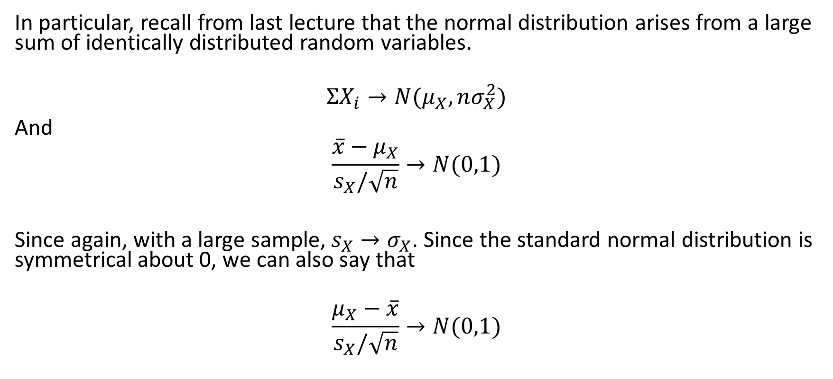
Confidence Intervals for the Mean
In particular, recall from last lecture that the normal distribution arises from a large sum of identically distributed random variables.
$$ΣX_{i}→N(μ_{X},nσ_{X}^{2})$$
And
$$\frac{\overline{x}−μ_{X}}{s_{X}/\sqrt{n}}→N(0,1)$$
Since again, with a large sample, $s_{X}→σ_{X}$. Since the standard normal distribution is symmetrical about 0, we can also say that
$$\frac{μ_{X}−\overline{x}}{s_{X}/\sqrt{n}}→N(0,1)$$

Slide 33
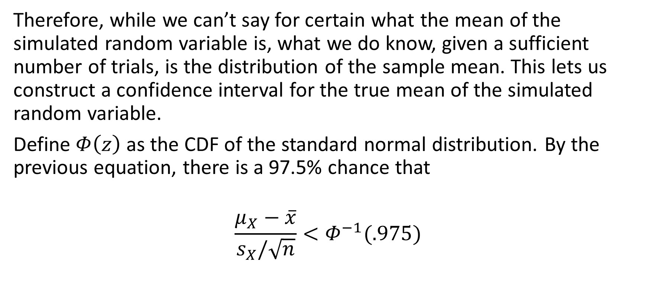
Confidence Intervals for the Mean
Therefore, while we can’t say for certain what the mean of the simulated random variable is, what we do know, given a sufficient number of trials, is the distribution of the sample mean. This lets us construct a confidence interval for the true mean of the simulated random variable.
Define $Φ\left(z\right)$ as the CDF of the standard normal distribution. By the previous equation, there is a 97.5% chance that
$$\frac{μ_{X}−\overline{x}}{s_{X}/\sqrt{n}}<Φ^{−1}(.975)$$

Slide 34

Confidence Intervals for the Mean
Therefore, there is a 97.5% chance that
$$μ_{X}<\overline{x}+\frac{{s_{X}∗Φ}^{−1}\left(.975\right)}{\sqrt{n}}$$
And a 95% chance that
$$\overline{x}−\frac{{s_{X}∗Φ}^{−1}\left(.025\right)}{\sqrt{n}}<μ_{X}<\overline{x}+\frac{{s_{X}∗Φ}^{−1}\left(.975\right)}{\sqrt{n}}$$

Slide 35
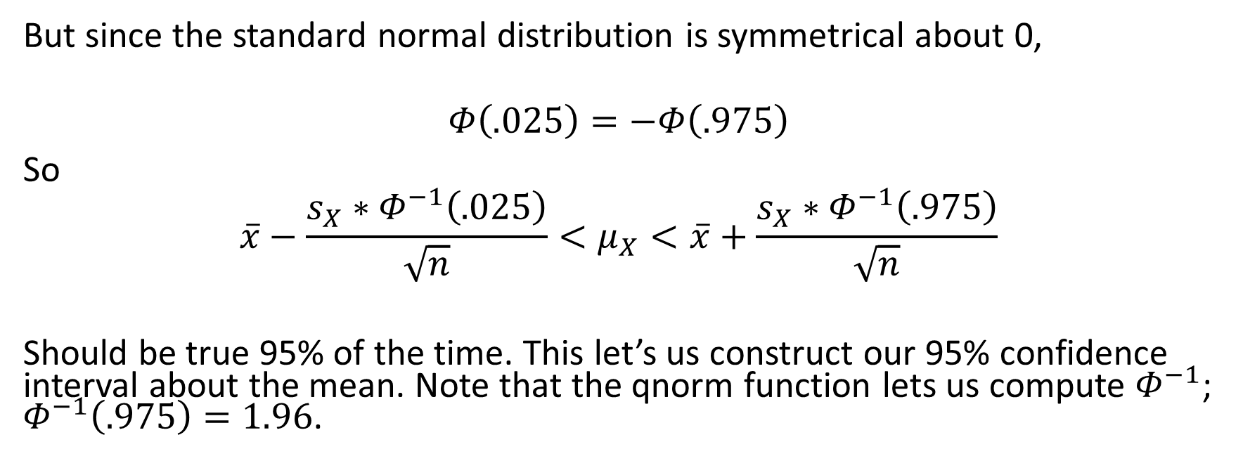
Confidence Intervals for the Mean
But since the standard normal distribution is symmetrical about 0,
$$Φ\left(.025\right)=−Φ\left(.975\right)$$
So
$$\overline{x}−\frac{{s_{X}∗Φ}^{−1}\left(.025\right)}{\sqrt{n}}<μ_{X}<\overline{x}+\frac{{s_{X}∗Φ}^{−1}\left(.975\right)}{\sqrt{n}}$$
Should be true 95% of the time. This let’s us construct our 95% confidence interval about the mean. Note that the qnorm function lets us compute $Φ^{−1}$; $Φ^{−1}\left(.975\right)=1.96$.
Figure 4.20

Slide 36
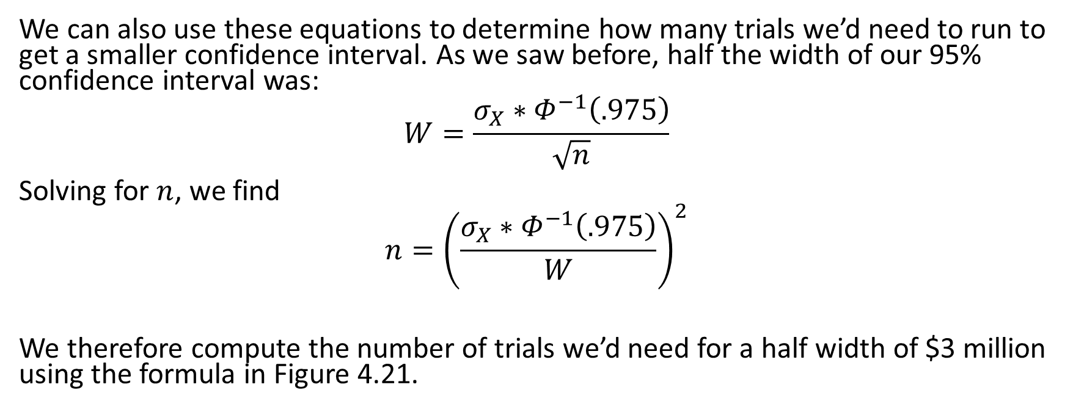
Confidence Intervals for the Mean
We can also use these equations to determine how many trials we’d need to run to get a smaller confidence interval. As we saw before, half the width of our 95% confidence interval was:
$$W=\frac{{σ_{X}∗Φ}^{−1}\left(.975\right)}{\sqrt{n}}$$
Solving for $n$, we find
$$n={\left(\frac{{σ_{X}∗Φ}^{−1}\left(.975\right)}{W}\right)}^{2}$$
We therefore compute the number of trials we’d need for a half width of $3 million using the formula in Figure 4.21.
Figure 4.21

Slide 37
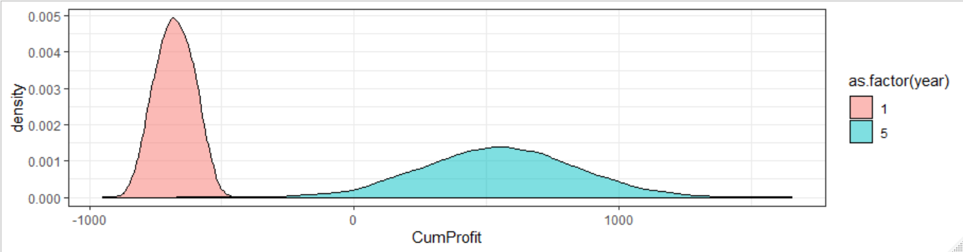
Overlay Charts
Our ymodel data frame makes it very easy for us to compare the distribution of cumulative net profit for different years in one chart. These results are reproduced in Figure 4.22. Here we want to only show years 1 and 5, so we filter ymodel accordingly.
We must specify how our data is grouped in the year and fill arguments to distinguish the things we’re comparing. The variance of the cumulative net profit in year 5 is larger than the variance of the cumulative net profit in year 1. This makes sense because there is more uncertainty in making long-term predictions.
Figure 4.22

Slide 38
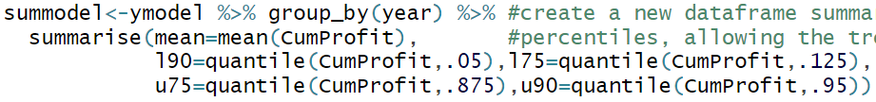
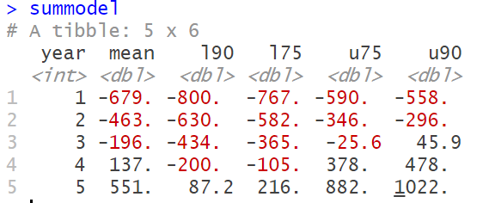
Trend Charts
We can also use ymodel to create a trend chart that compares how our data is changing from year to year.
We first summarize our model, determining the mean 75%, and 90%, confidence intervals for each year in a new data frame (summodel). We name these mean, l75, u75, l90, and u90.
For each year, our cumulative net profit has a 75% chance of falling between l75 and u75, and a 90% chance of falling between l90 and u90.
Figure 4.23

Slide 39
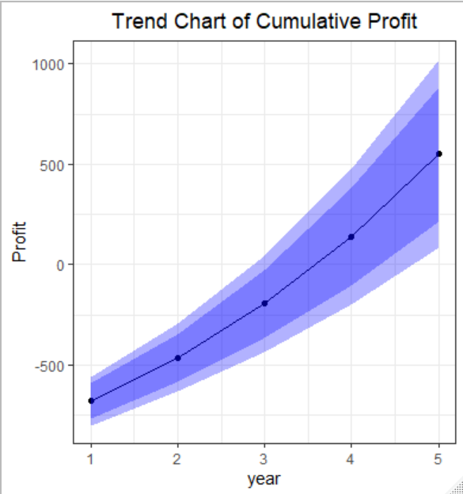
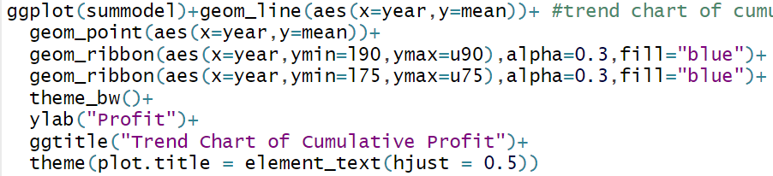
Trend Charts
We then plot it in ggplot.
We use a geom_line and geom_point to represent the means, and geom_ribbon to represent the two confidence intervals.
The alpha argument to geom_ribbon controls how transparent the ribbons are. Mean net cumulative profit increases over time.
The 75 percent band and the 90 percent band are getting wider as we move to the right on the horizontal axis. This shows that variation around the net cumulative profit increases over time.
Figure 4.24

Slide 40
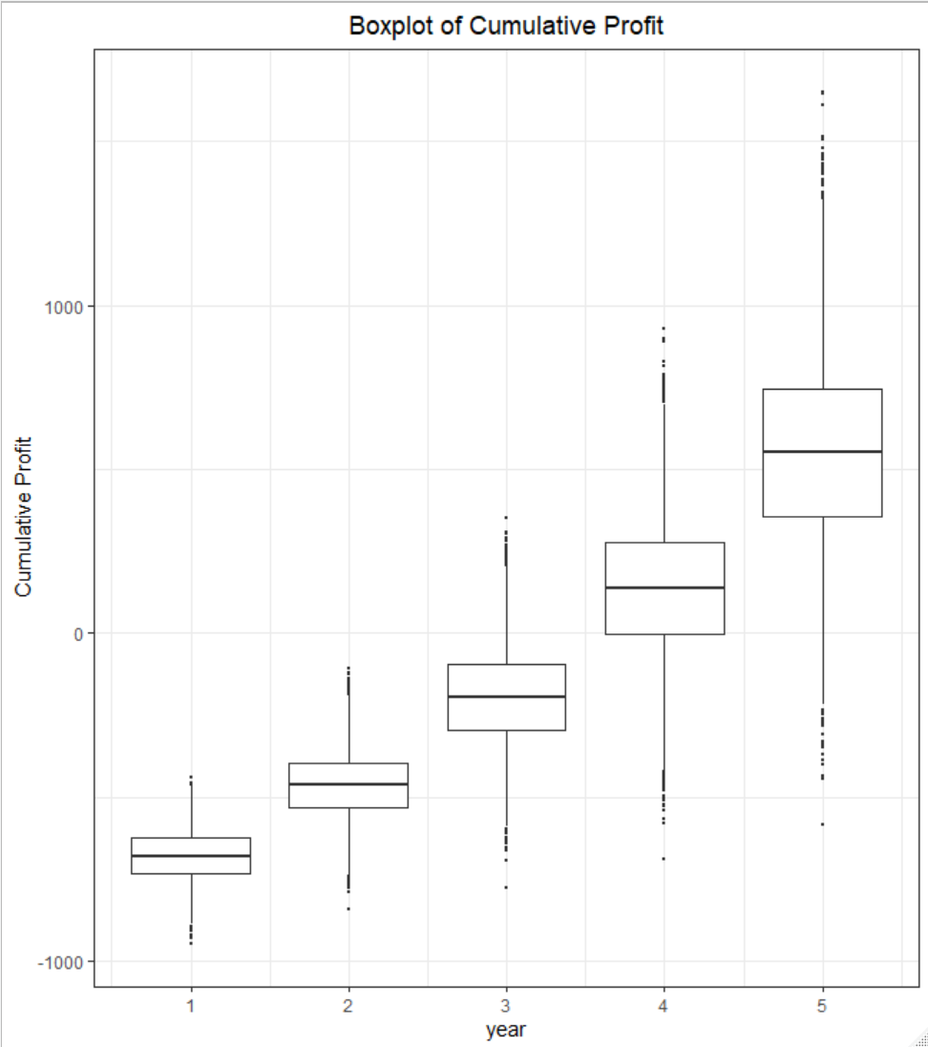
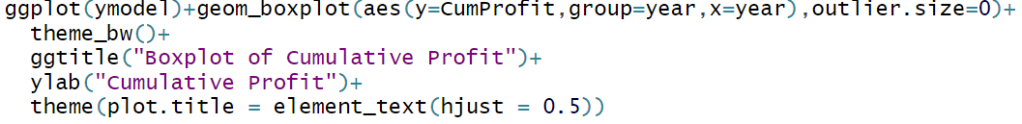
Boxplots
Boxplot charts help to visualize the statistical properties of the output variable.
In R, geom_boxplot will display the 1st and 3rd quartiles, represented by the box, the median, represented as a horizontal line through the box, and vertical lines which are at most 1.5 times the length of the interquartile range, extending above and below the box. Any data that fall past the vertical lines are considered outliers and given their own points.
Again, we group our data by year.
Figure 4.25

Slide 41
Sensitivity Analysis
One form of sensitivity analysis is to measure the correlation between the inputs and outputs of the model. We will produce a tornado chart which measure the effect of each uncertain input in our model on the NPV. Once it’s determined which elements have the highest correlation (positive or negative), a wise organization might prioritize those inputs which have the highest effect on its success.

Slide 42
Sensitivity Analysis
In order to perform this operation, we need to pull our uncertain inputs from the nested data frames to measure their impact on NPV. We do this for market size growth and market share growth.
We first write function that pulls the column from nmodel, then lapplies it to smodel. The result is a list of 10000 lists.
We use unlist to turn it into a vector of 50,000 elements.
Next, we turn it into a matrix with 5 rows and 10,000 columns. We then transpose this into a matrix of 10,000 rows and 5 columns.
Finally, we turn it into a data frame, remove the first column (of all ones), and name the columns after the year they represent.
These steps are precisely the same for both market size and market growth.
Individual Exercise:
Run each step one at a time to see each step transforms the eventual data frame.

Slide 43
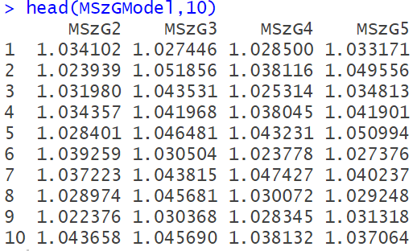
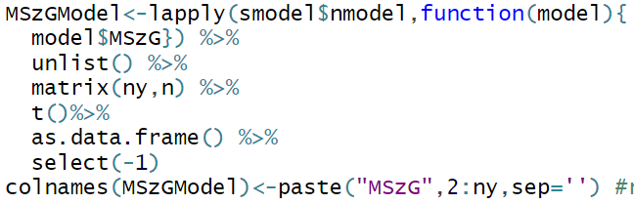
Sensitivity Analysis
The code to run these operations and resulting data frame are reproduced in Figure 4.26.
Figure 4.26

Slide 44
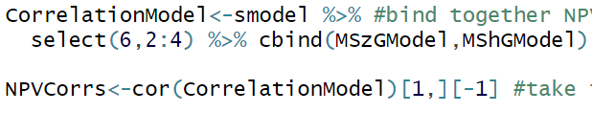
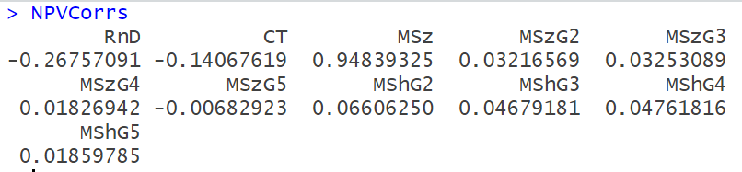
Sensitivity Analysis
We are now ready to create a data frame containing all the uncertain inputs we started with and the output we want to measure (NPV). We select NPV RnD, CT, and MSz from smodel, then cbind it to our data frames for Market Share and Market Size, creating “CorrelationModel”.
We then create a correlation matrix for CorrelationModel using the cor function.
Since we’re only interested in correlations with NPV, we select the first row of the matrix.
The first element is the correlation of NPV and itself, guaranteed to be 1. We remove it from the vector.
The code for this and result can be seen in Figure 4.27.
Figure 4.27

Slide 45
Sensitivity Analysis
All that remains to do is plot this in a bar chart. We have to change what the bar chart is measuring, using the stat argument, or else it will count elements rather than just displaying the value.
We use the reorder function to put the highest magnitude values at the top, and set the fill to check whether the correlation is positive or negative.
The scale_fill_manual function will then set the color and remove the legend.
coord_flip rotates the graph by 90 degrees.
The result can be seen in figure 4.28.

Slide 46
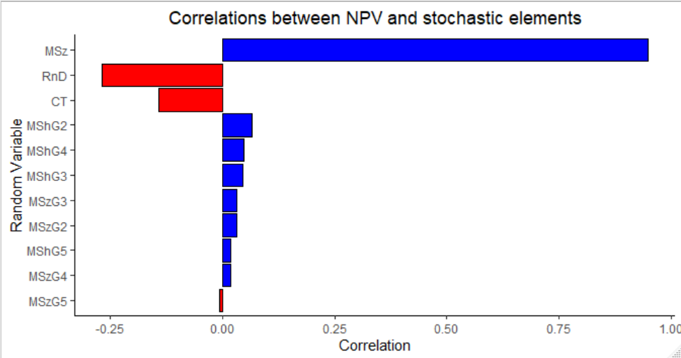
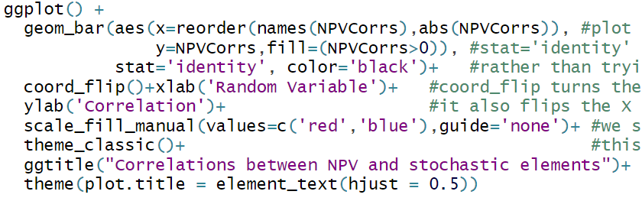
Sensitivity Analysis
Figure 4.28

Slide 47
Sensitivity Analysis
The initial market size has a strong positive correlation of 0.95 with NPV. It has by far the largest impact on NPV.
The R&D cost has a negative correlation of 0.255 with NPV and the clinical trial cost has a negative correlation of 0.130 with the NPV.
As market size increases, NPV increases whereas as each of R&D cost and clinical trial cost increases, NPV decreases.
All other uncertain input variables have little effect NPV.
If you want to estimate NPV better, you should focus your efforts on obtaining better information about the market size. You should pay close attention to what distribution you use to model the market size as this distribution has a huge impact on the resulting NPV.
The NPV and the market growth factors have negligible correlation. This suggests that we can use constant values instead of probability distributions to model the market growth factors. Using constant values would have little impact on the results

Slide 48
Lecture 4 Footnotes
¹ Evans, J. R., Business Analytics: Methods, Models, and Decisions, 2e, 2016, Pearson Education, Inc., Chapter 11, Example 11.8, pp. 351-352. ² Evans, J. R., Business Analytics: Methods, Models, and Decisions, 2e, 2016, Pearson Education, Inc., Chapter 11, Example 11.8, p. 351. ³ Adapted from Evans, J. R., Business Analytics: Methods, Models, and Decisions, 2e, 2016, Pearson Education, Inc., Chapter 11, Example 11.8, p. 351
⁴ Evans, J. R., Business Analytics: Methods, Models, and Decisions, 2e, 2016, Pearson Education, Inc., p. 80.

Slide 49
Lecture 4 References
Evans, J. R., Business Analytics: Methods, Models, and Decisions, 2e, 2016, Pearson Education, Inc., Chapter 11, Example 11.8, pp. 351—352.
Evans, J. R., Business Analytics: Methods, Models, and Decisions, 2e, 2016, Pearson Education, Inc., Chapter 12, p. 388—391.
Evans, J. R., Business Analytics: Methods, Models, and Decisions, 2e, 2016, Pearson Education, Inc., p. 80.
Albright, S. C. and W. L. Winston, Business Analytics: Data Analysis and Decision Making, 2015, Cengage Learning, p. 900.
Frontline Solvers 2015 Reference Guide, p. 270.
Evans, J. R., Business Analytics: Methods, Models, and Decisions, 2e, 2016, Pearson Education, Inc., p. 392.
Evans, J. R., Business Analytics: Methods, Models, and Decisions, 2e, 2016, Pearson Education, Inc., p. 394.

Slide 50
Lecture 4 Summary Questions
What is a “percentile” and what is its relation with risk management?
What is a “confidence interval”? What does a 99% confidence interval tell us?
What is the importance of determining “the number of iterations” in a simulation study?
How do we determine the “number of iterations” in a simulation study?
What is the role of a “sensitivity chart” in Frontline’s Analytic Solver Platform?
What is the purpose of an “overlay chart” and a “trend chart”?

